Slide 1
Optimizing hyperparameters

Slide 2
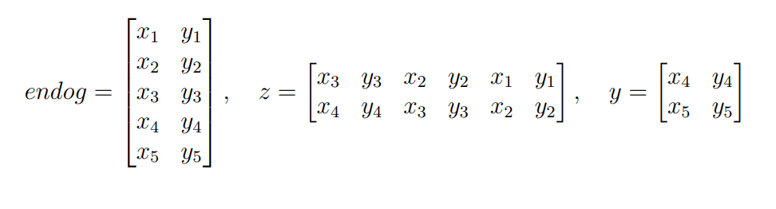
Example with two trajectories
Input = 5
Lag = 3

Slide 3
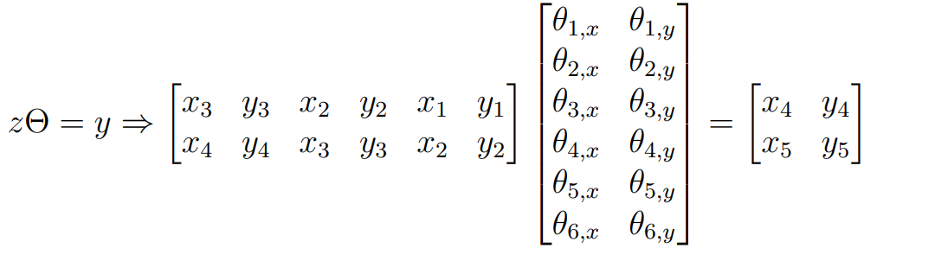
Example with two trajectories
Input = 5
Lag = 3

Slide 4

Model
Finding parameters Θ which minimizes the least squares of
In this specific version of the model z and y contain all force trajectories
Using inverse matrix and Normal equation
Performs badly with underdetermined matrices
Input-max_lags >= max_lags*N_atoms*3
Fails with singular matrix
For ethanol I needed an input of 50 time steps
Using SVD
Performs well as long as input > max_lag
Focused on this version

Slide 5
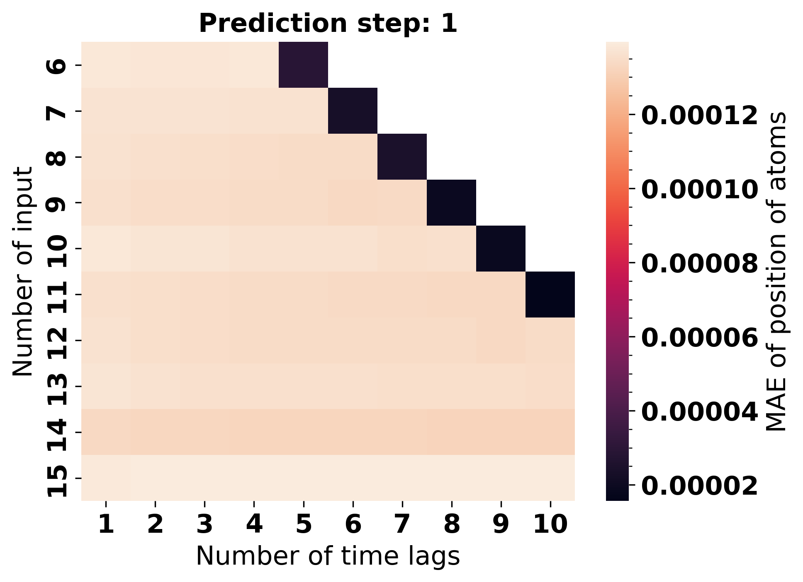

Slide 6
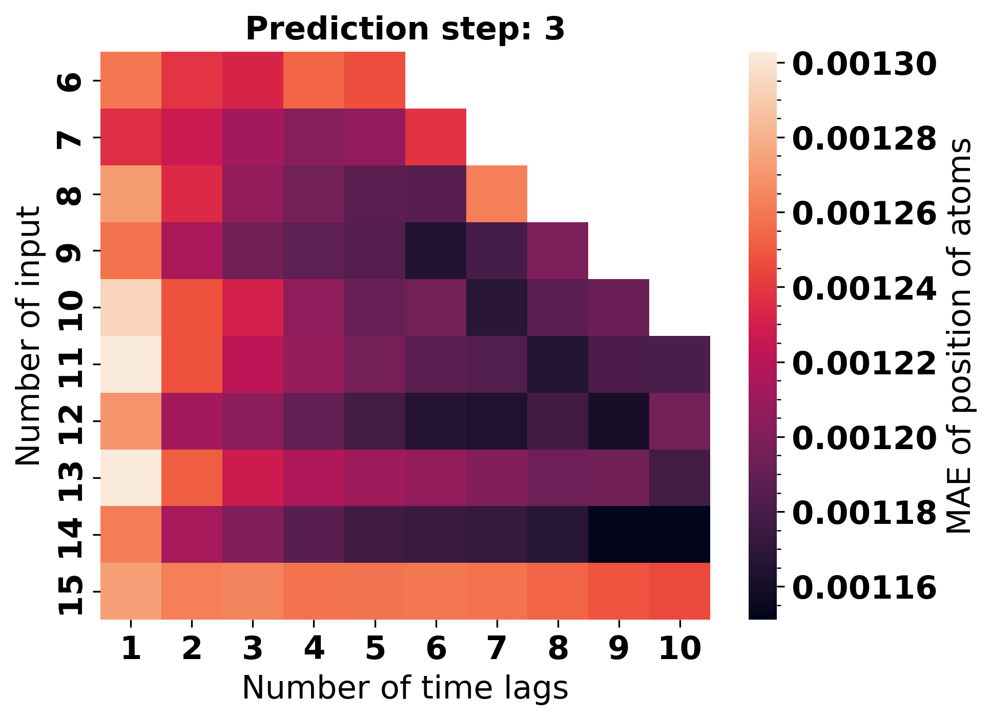

Slide 7
Combinations of hyperparameters used

Slide 8
Choosing alpha
The best-performing model for pred=1 has alpha=0
Regularization performs better relative to no regularization at higher predictions
Higher time lag results in higher alpha being optimal
While regularization does not improve the average performance it might still improve the model by removing large outliers
It makes to further optimize alpha if models can predict several steps without destroying the simulation

Slide 9
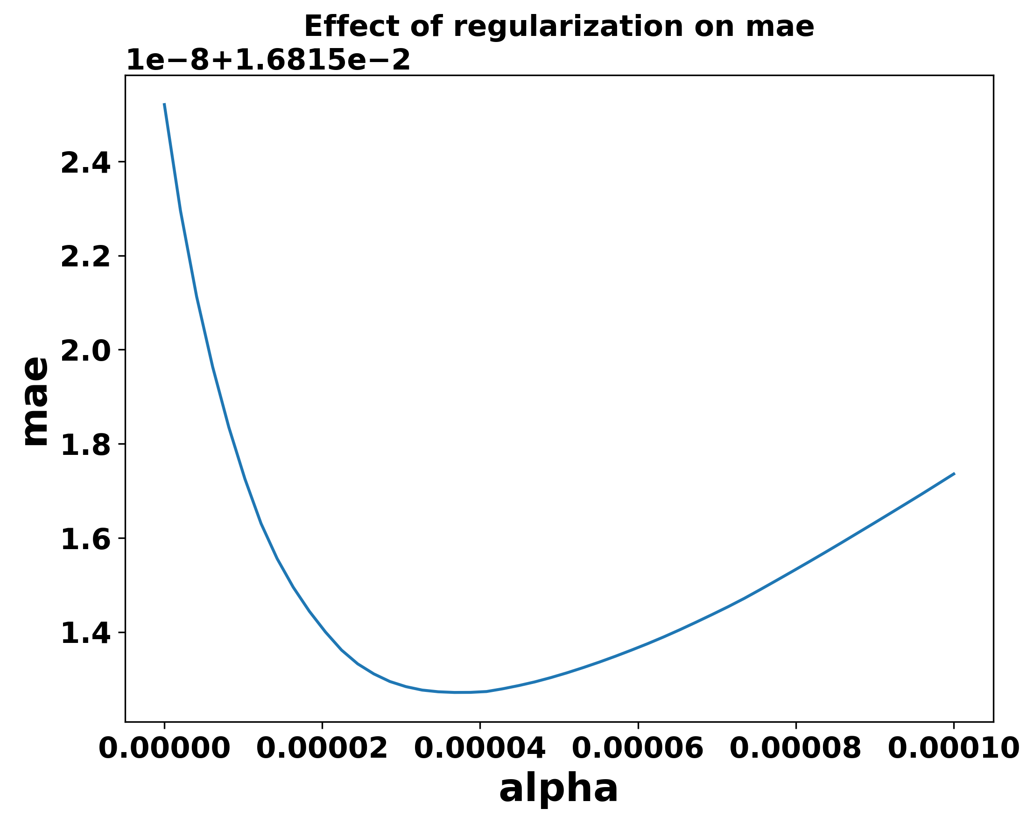
Averaging input, max lag, and pred
Lag :6
Min mae: alpha = 3.67e-05

Slide 10
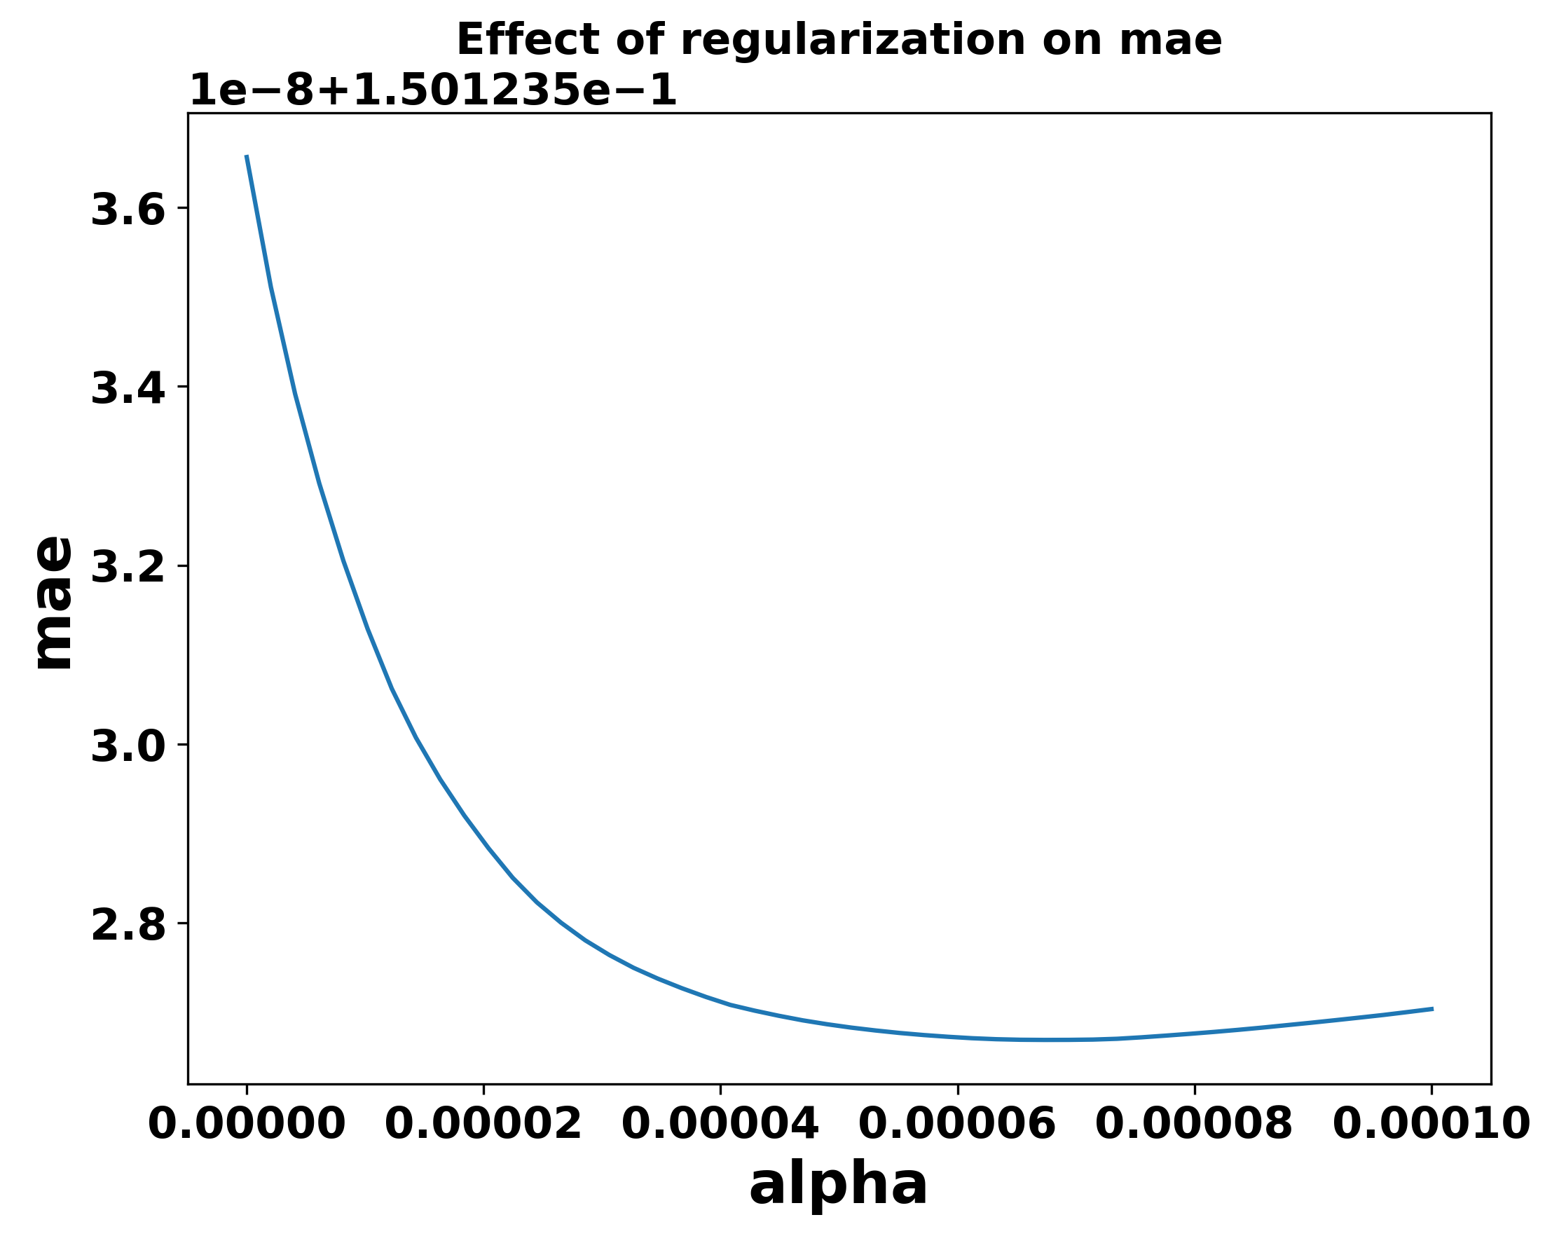
Averaging input, max lag, and pred
Lag :10
Min mae: alpha = 6.74e-05

